Slide 1
Goal: calculate tag location in 3d environments in real time with NLoS TDoA based on PnPLoc
How: identify NLoS signal and path info (# of reflection; penetration; path length)
from Energy strength in CIR peak signal
real time: light computation
Initial thoughts:

Slide 2
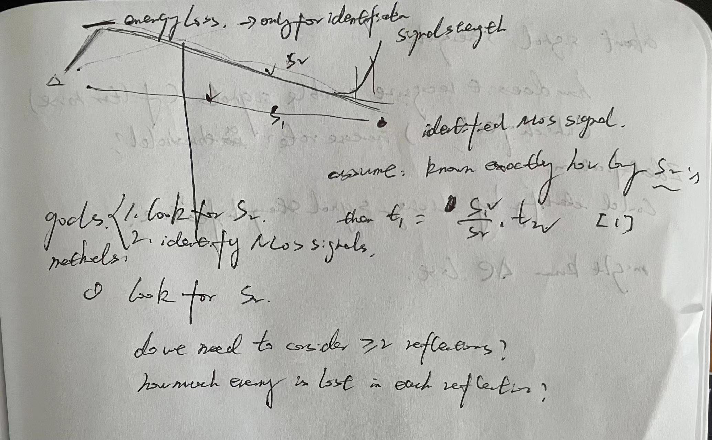

Slide 3
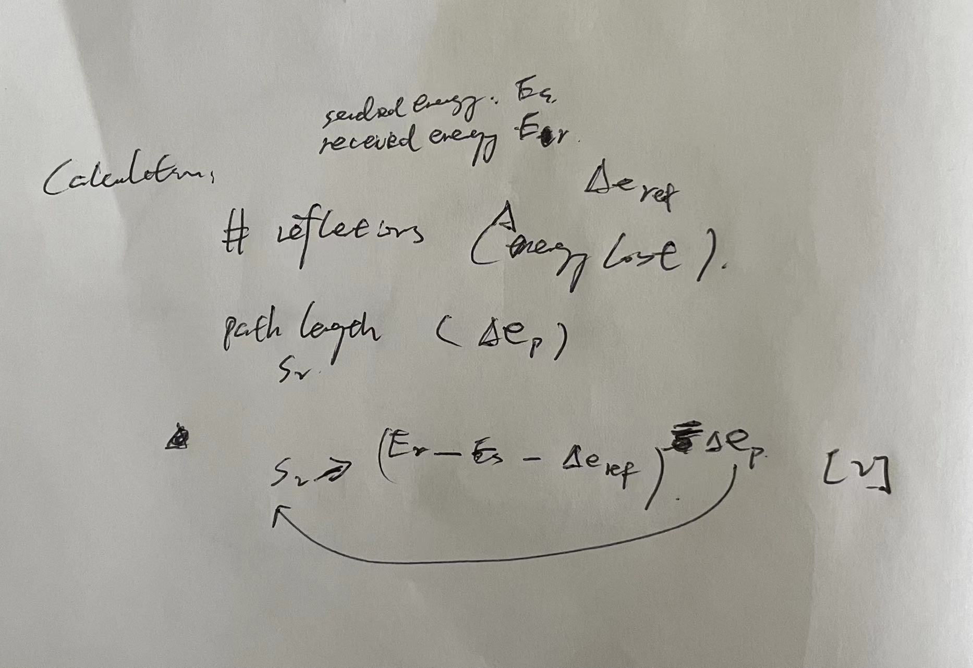

Slide 4
Originality:
None of the current works tackle the NLoS problem for indoor localization by focusing on signal attenuation and distortion in complicated real world environment.
Classify signals into LoS, NLoS, and severe NLoS based on signal strength
Information needed:
Energy path loss;
Energy lost for each reflection;
…. For each wall penetration
NLoS Identification also based on energy strength

Slide 5
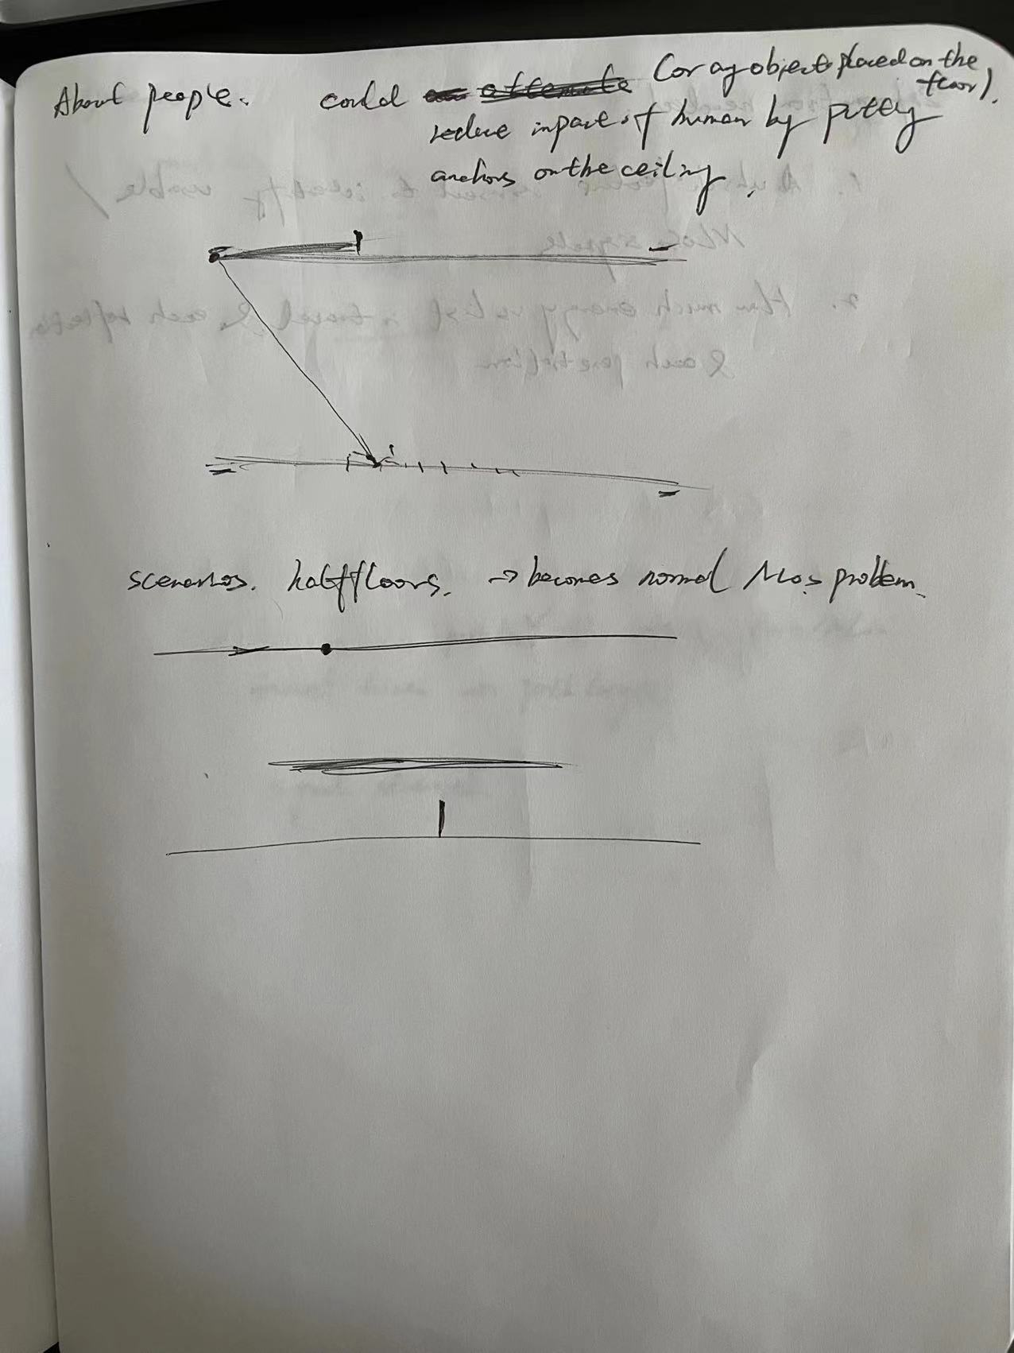

Slide 6
Goal: calculate tag location in 3d environments in real time with NLoS TDoA based on PnPLoc
real time: light computation
Idea:
Try to pick the actual first path signal (exclude first path signals in severe NLoS by setting threshold)
How: labeling anchor signals(anchor id); set threshold by testing FP_PW in NLoS setup
Information needed:
How does Arduino pick first path power(can we assume it to be close enough)(DW1000.getFirstPathPower())
If so, how to get the arrival time of the first path signal in Arduino
Which signal are we using for current TDoA calculation? FP/peak signal

Slide 7
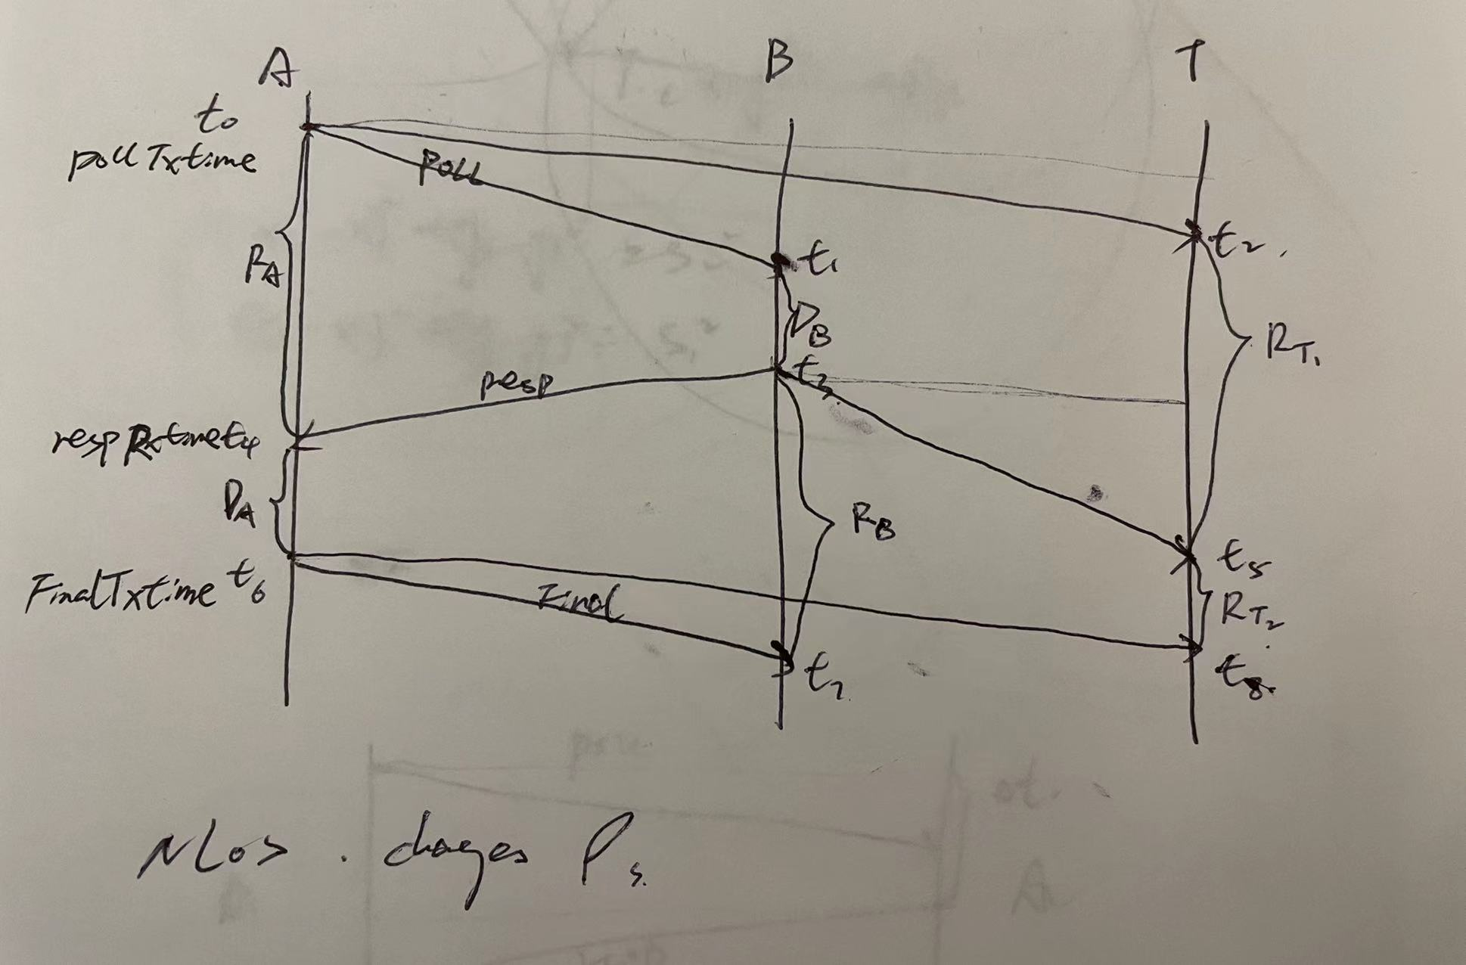

Slide 8
Reason for erroreous pollTxTime; respRxTime…:
signal processing time within Arduino board (causes 20cm of error) happens in LoS
Recorded time for the wrong signal

Slide 9
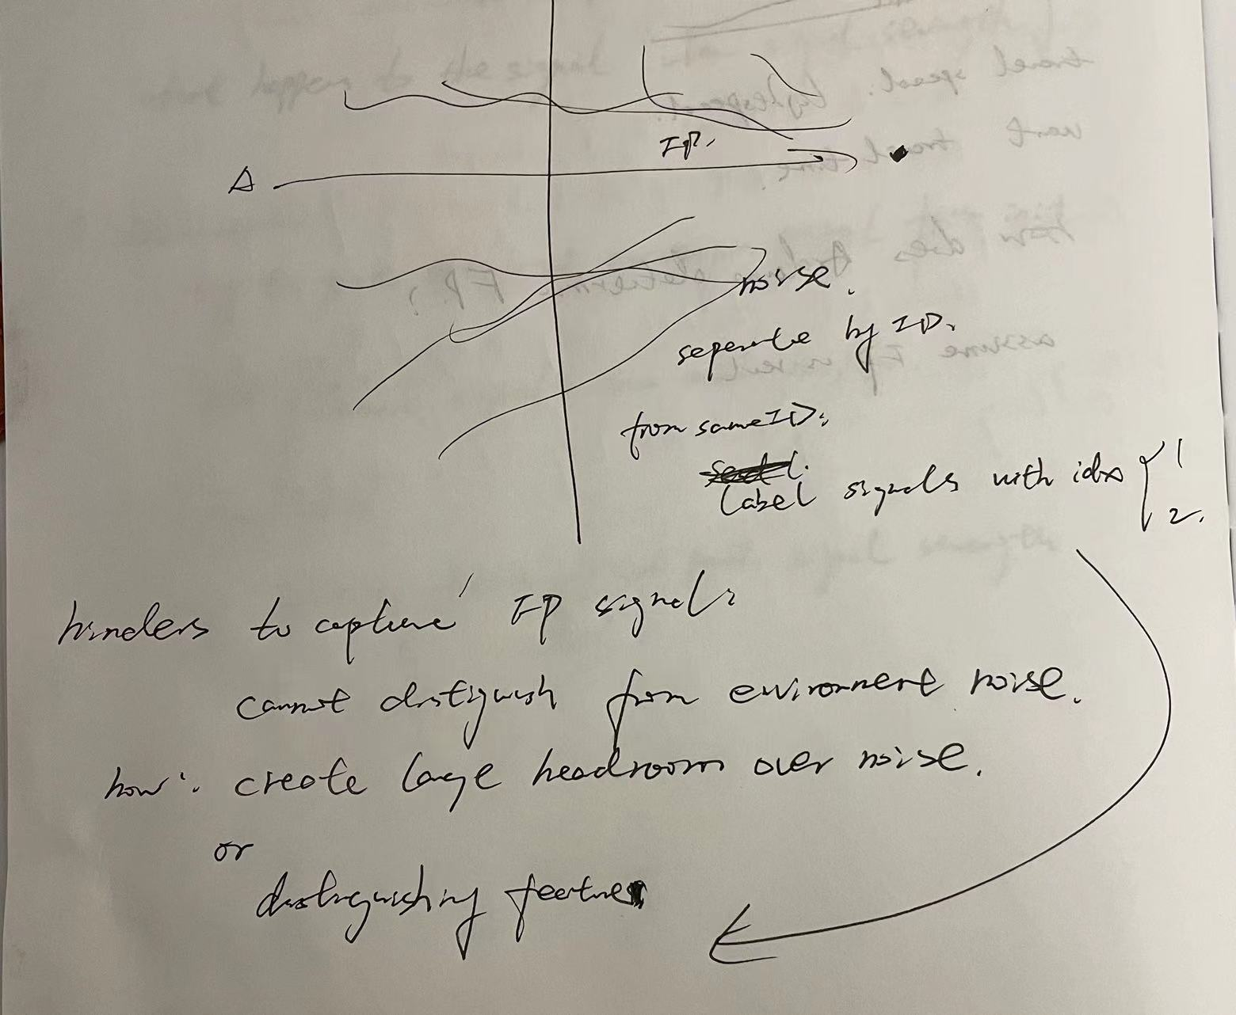

Slide 10
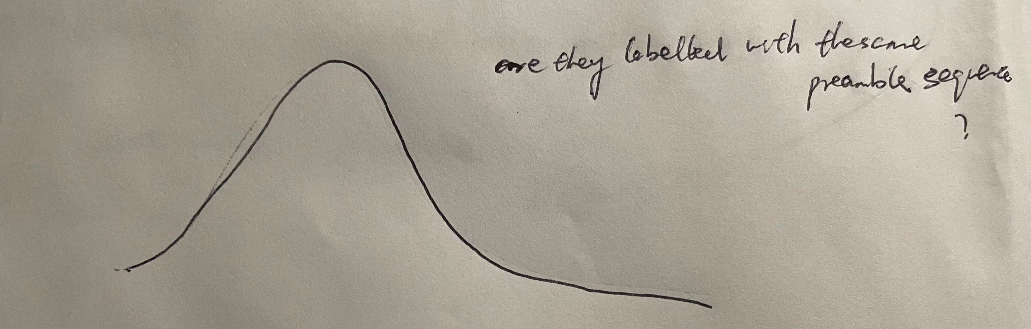
How DW1000 distinguish first path signal: (DW1000 User Manual)
LDE algorithm;
NTM = 12 or 13(best performance) “Noise Threshold Multiplier. This is a factor by which the observed noise level is multiplied to set
the threshold for the LDE algorithm’s first path search. “
PMULT = 3(best performance) “Peak Multiplier. This sets a factor by which the peak value of estimated noise is increased in order
to set the threshold for first path searching.”
Preamble sequence “The preamble is a repeated sequence of pulses following a pattern defined in the IEEE 802.15.4 standard. “
” On each numbered channel the 802.15.4 standard defines two preamble codes for the nominal 16 MHz PRF (pulse repetition frequency)
and four preamble codes for the nominal 64 MHz PRF. “
Idea: add one ”preamble bit” to the signal and flip the node for each round of transmission → separate noises with the same
Preamble sequence
Information needed: how to see the preamble sequence of noises; if preamble distinguishes channels, how are Poll msg sent and
received on channel level?

Slide 11
To minimize inter-symbol interference(ISI): Cyclic prefix
To reduce errors by preamble structures:
The problem I want to solve: time estimation accuracy in multipath wireless communication

Slide 12
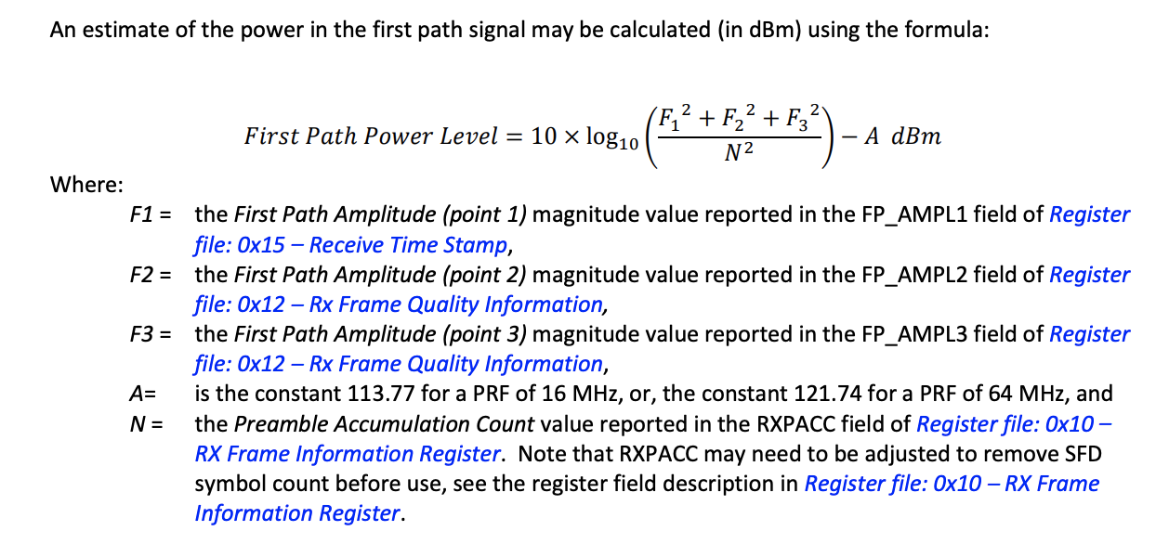
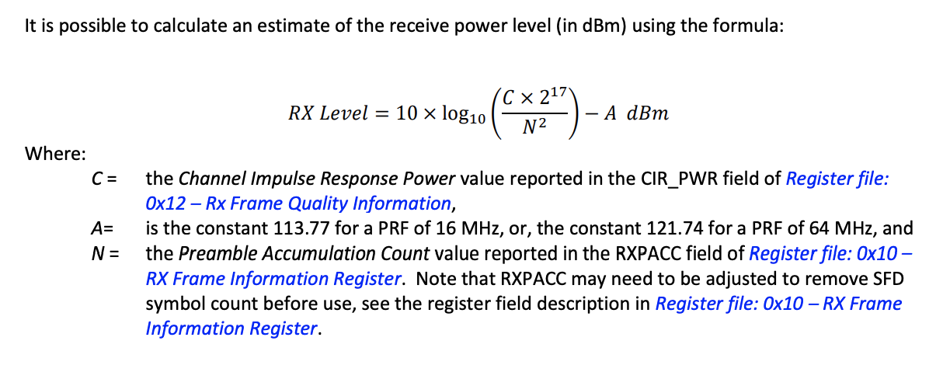

Slide 13
Contour map website:
Cannot predict actual Tdoa. Thus, cannot predict error based on Tdoa/Twr algorithm & anchor locations
Location calculation should be accurate based on algorithm
Localization error causes in LoS:
Things we cannot do much about:
signal processing time in Arduino board;
signal interference

Slide 14
Multi-Floor Seperation:

Slide 15
FP_PW: -80 LoS in conference room
Decrease to -110 after 3-4 walls or one ceiling in Klaus(precast concrete; worse if made of congregated steel)
Then undetectable
So anchors need to be deployed every 3-4 walls on each floor for full coverage
>=2 walls: cannot hear from all 3 anchors cannot calculate location
or TDoA too large, filtered out
Calculate path loss: Log distance model with floor attenuation factor
Current state:
Added floor id
Filter TDoA smaller than threshold
Tag aligns its floor id with character signal(first signal received; beacon signal);
If other_FPPW from one floor > this_FPPW(the last signal from this floor) for 5 times in a row,
change tagFloor to other_FPPW;

Slide 16
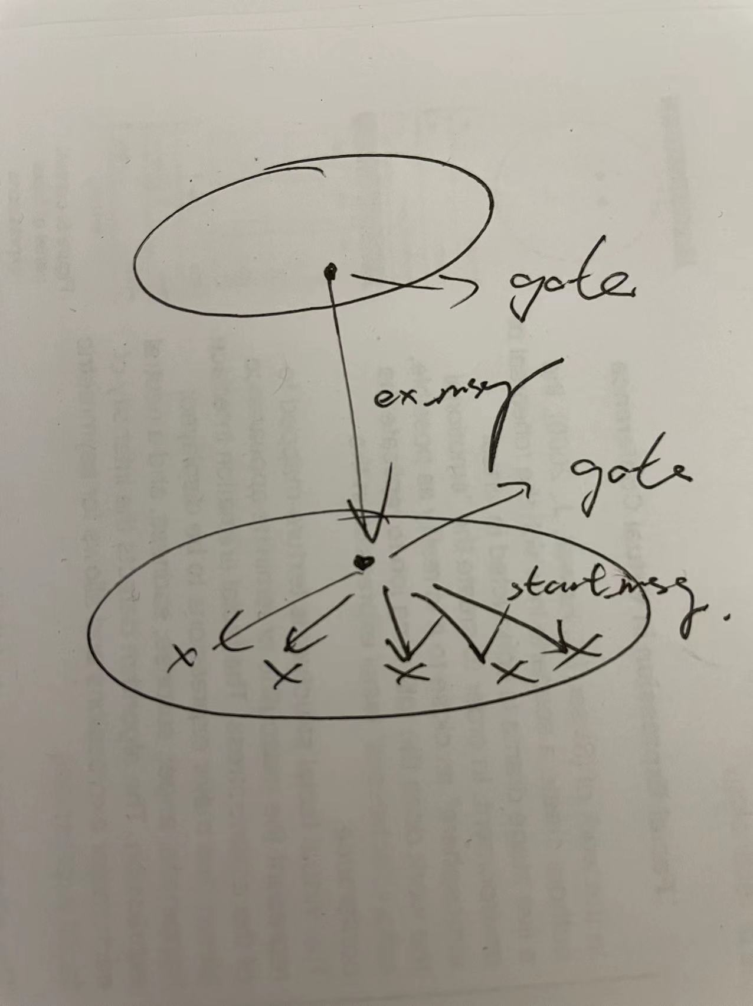
Record # of msgs:
Reduce number of messages
Optimization:
Send start msg again
Draw a timing diagram

Slide 17
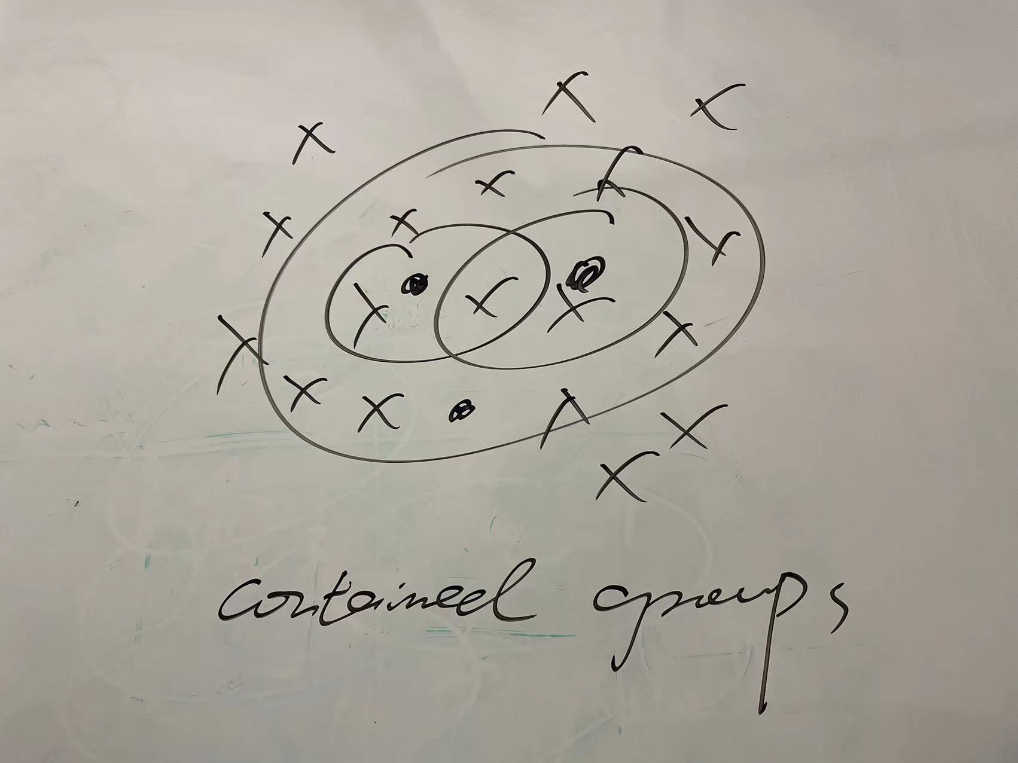

Slide 18
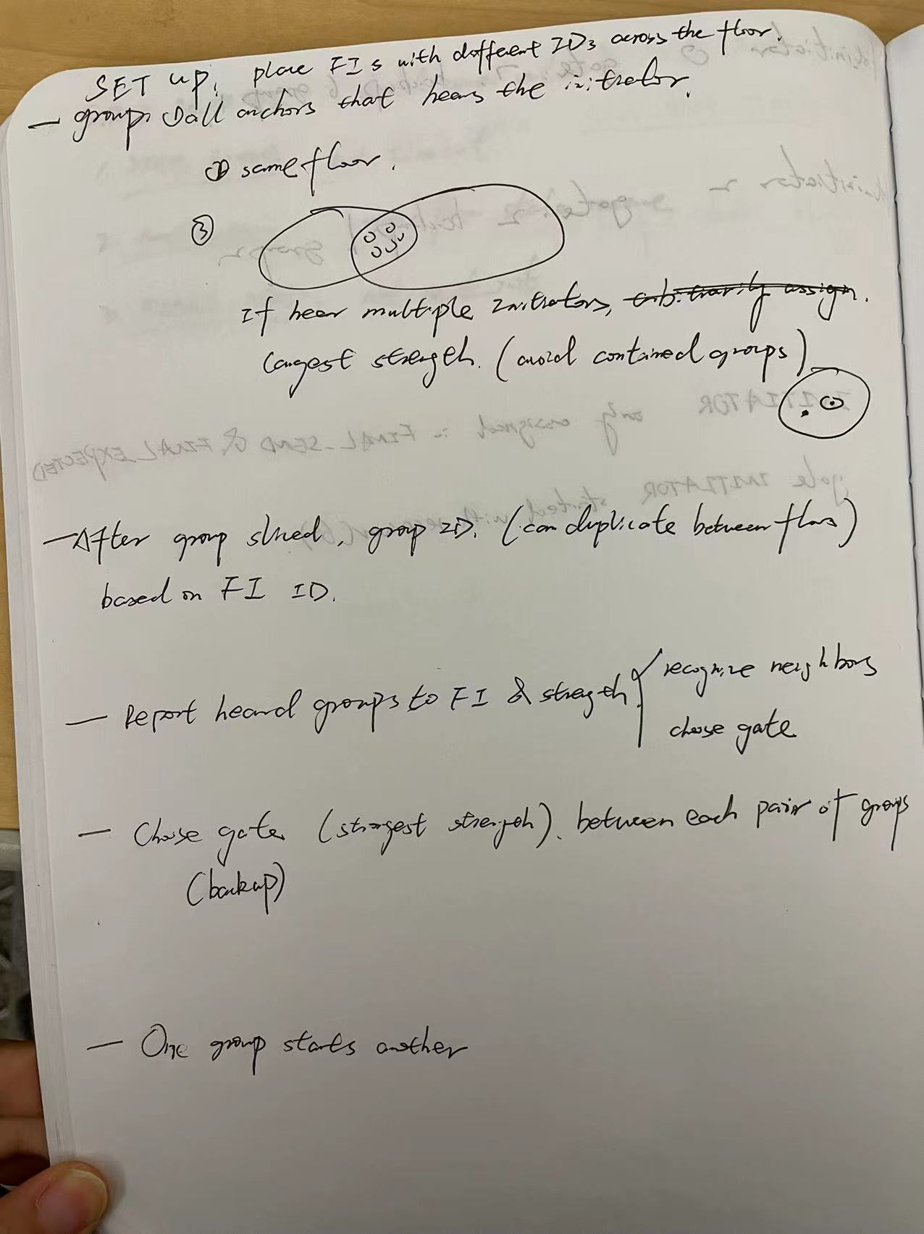

Slide 19
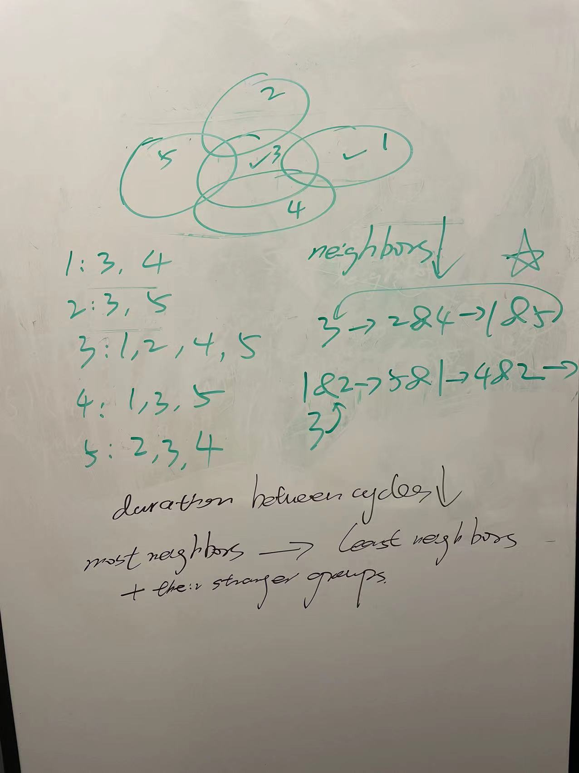
Similar group size

Slide 20
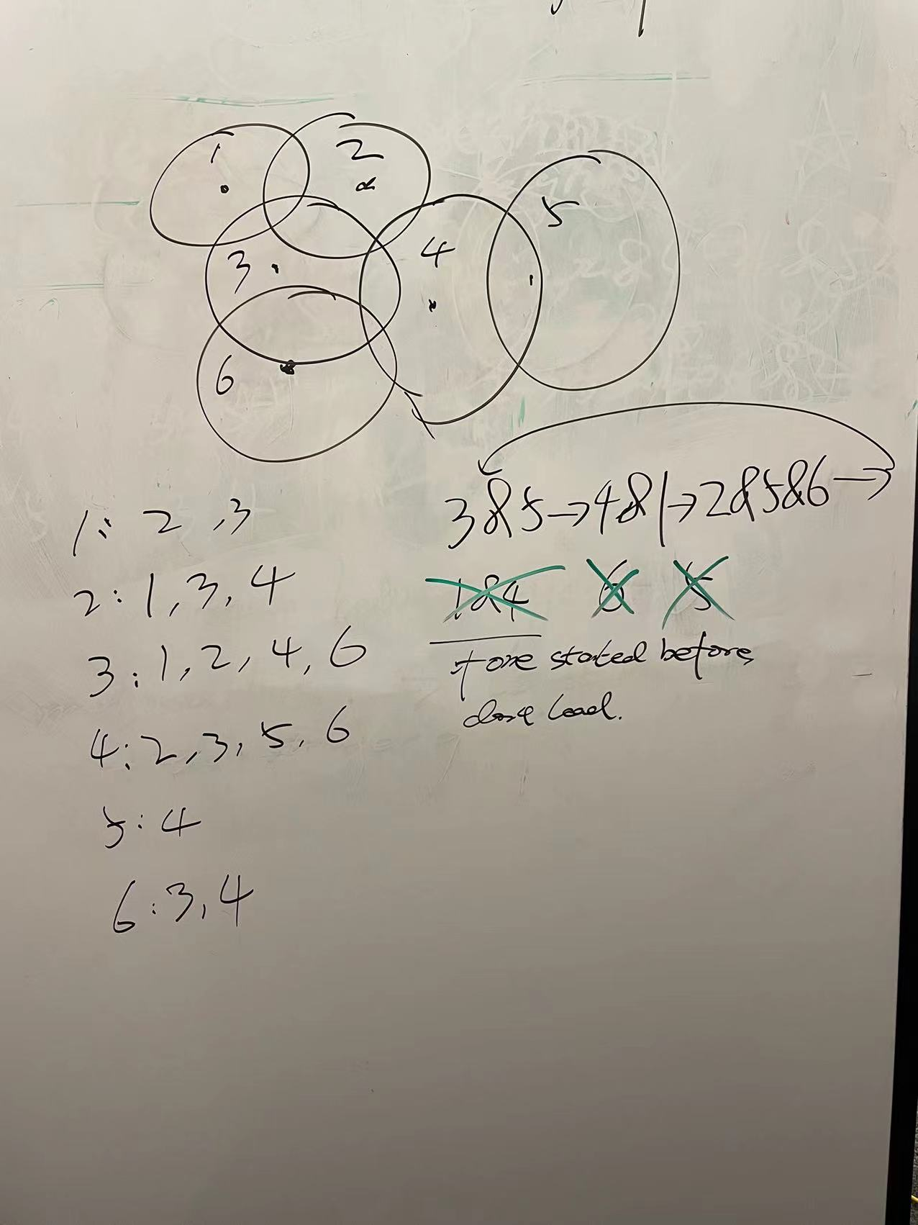
Graph:
Update rate&fairness

Slide 21
Same anchor locations for 100 times: zsh: killed(out of memory)
analysis: 861samples*8inits*8resp*100counts+errorlist861*8*2(twolists)
Same issue for 50 times

Slide 22
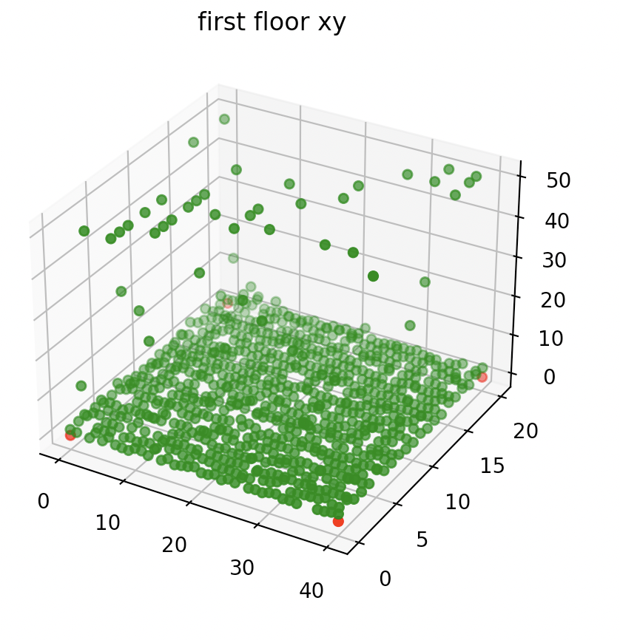
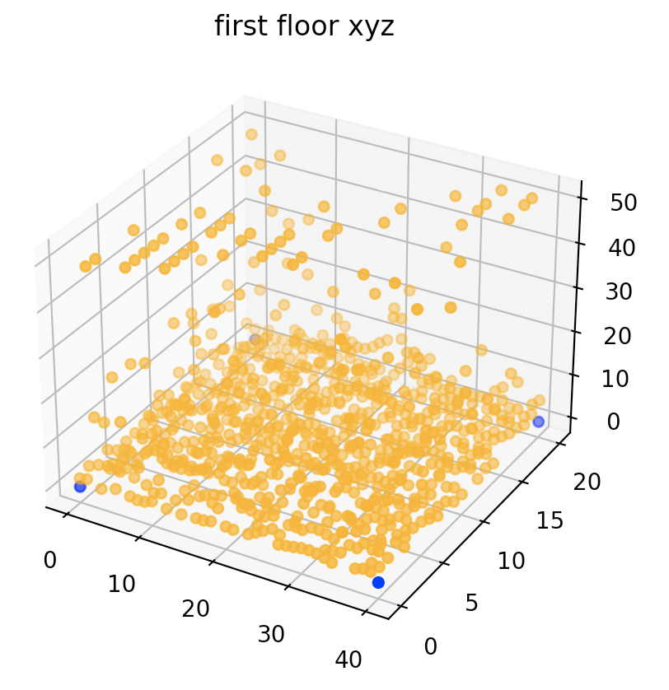
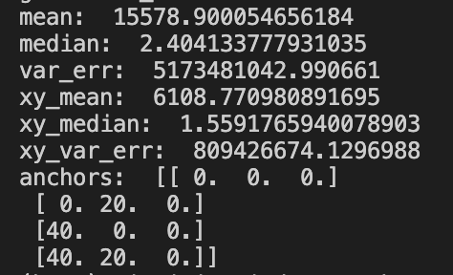
One set of anchors for 10 times, each time with one round of rotation for initiating with DoP, noise mu = 0&var = 1m
Anchors 1st floor; samples 1st floor:
Median of errors for each sample point on x,y coordinates
Median of errors for each sample point on x,y,z coordinates

Slide 23
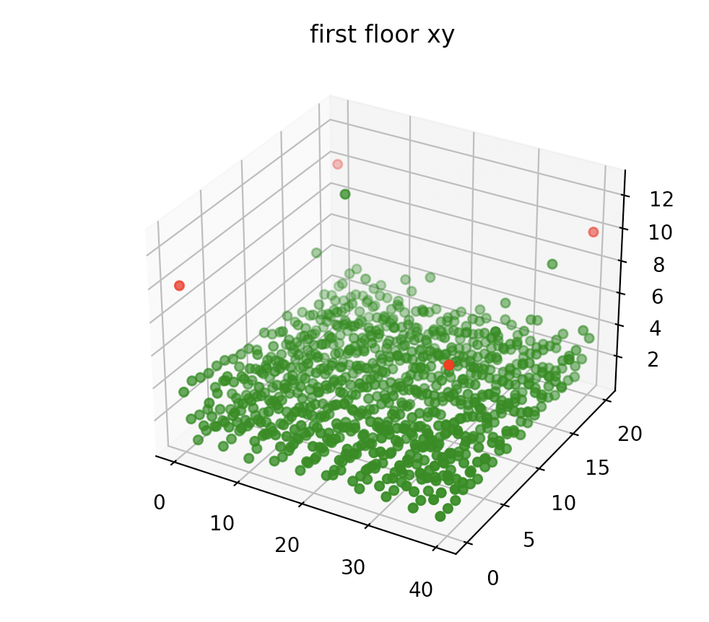
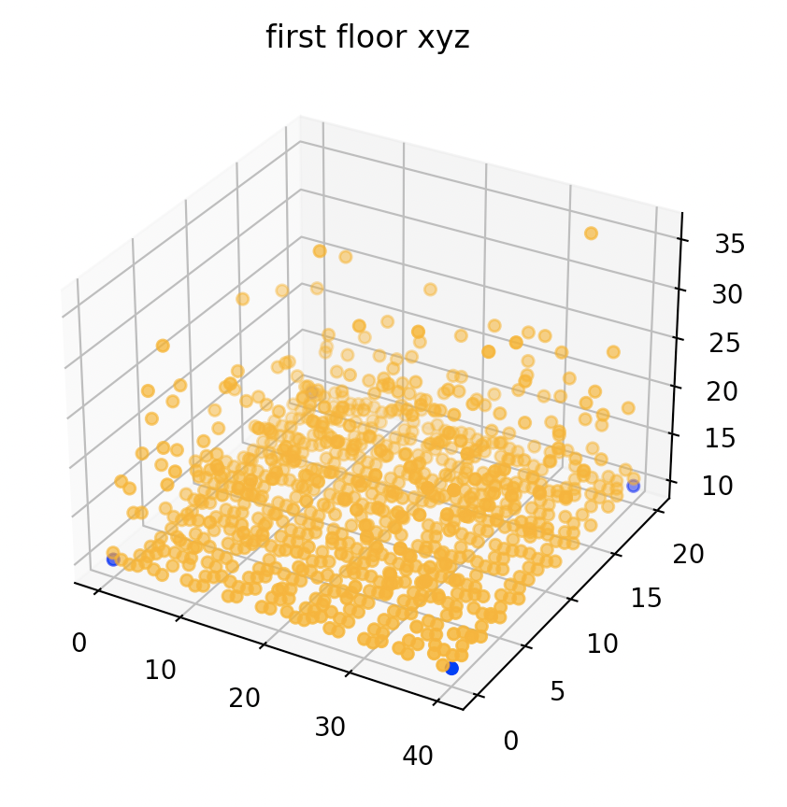
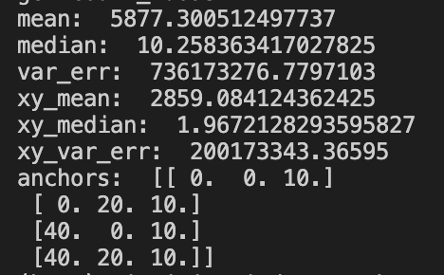
One set of anchors for 10 times, each time with one round of rotation for initiating with DoP, noise mu = 0&var = 1m
Anchors 2nd floor; samples 1st floor:
Median of errors for each sample point on x,y coordinates
Median of errors for each sample point on x,y,z coordinates

Slide 24
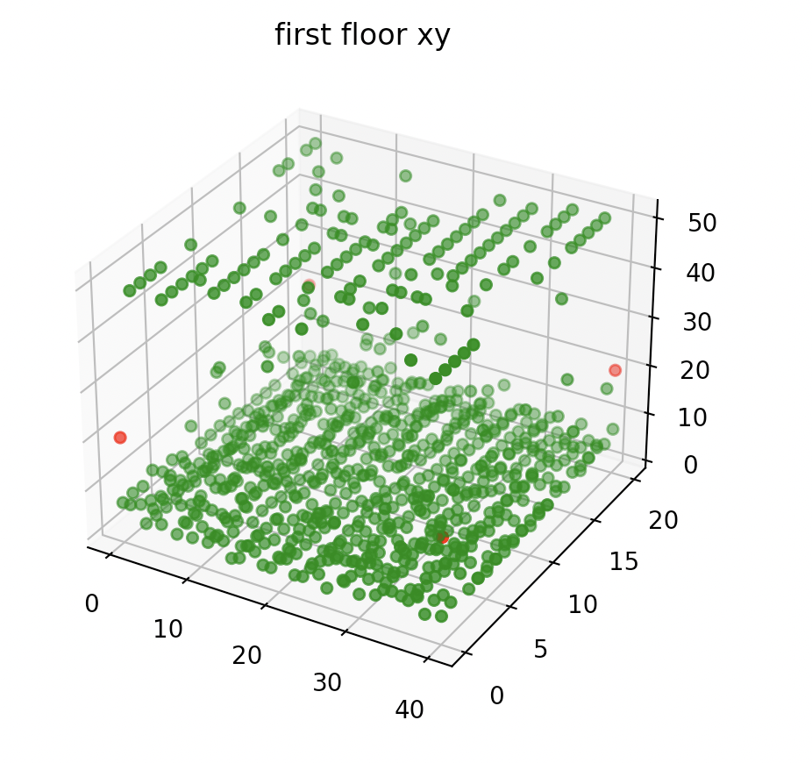
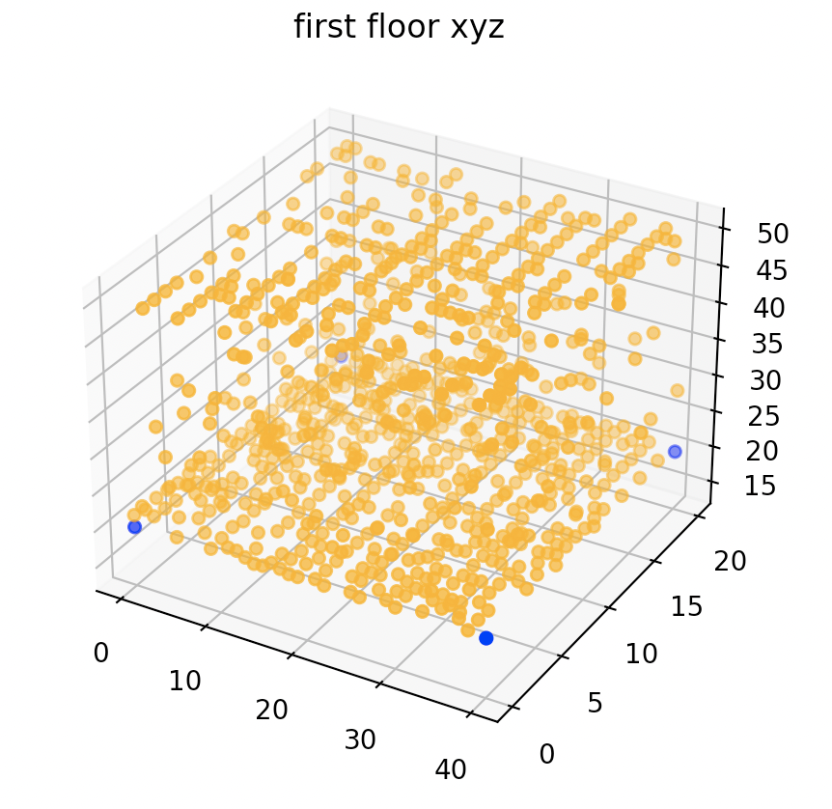
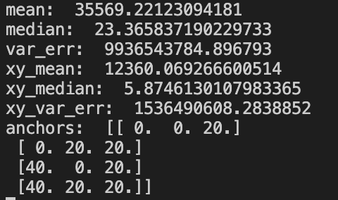
One set of anchors for 10 times, each time with one round of rotation for initiating with DoP, noise mu = 0&var = 1m
Anchors 3rd floor; samples 1st floor:
Median of errors for each sample point on x,y coordinates
Median of errors for each sample point on x,y,z coordinates

Slide 25
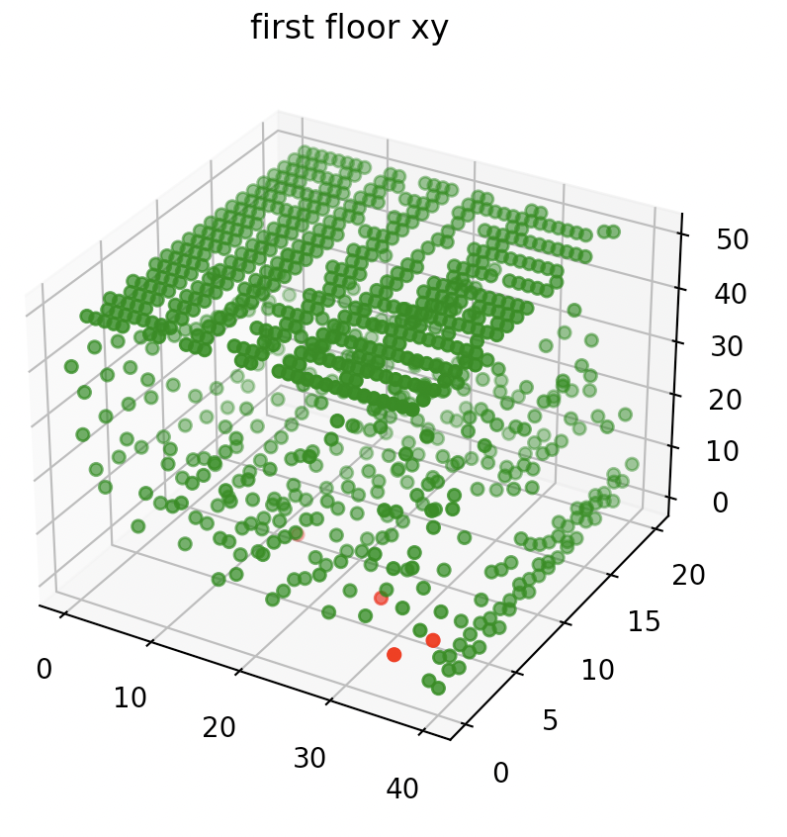
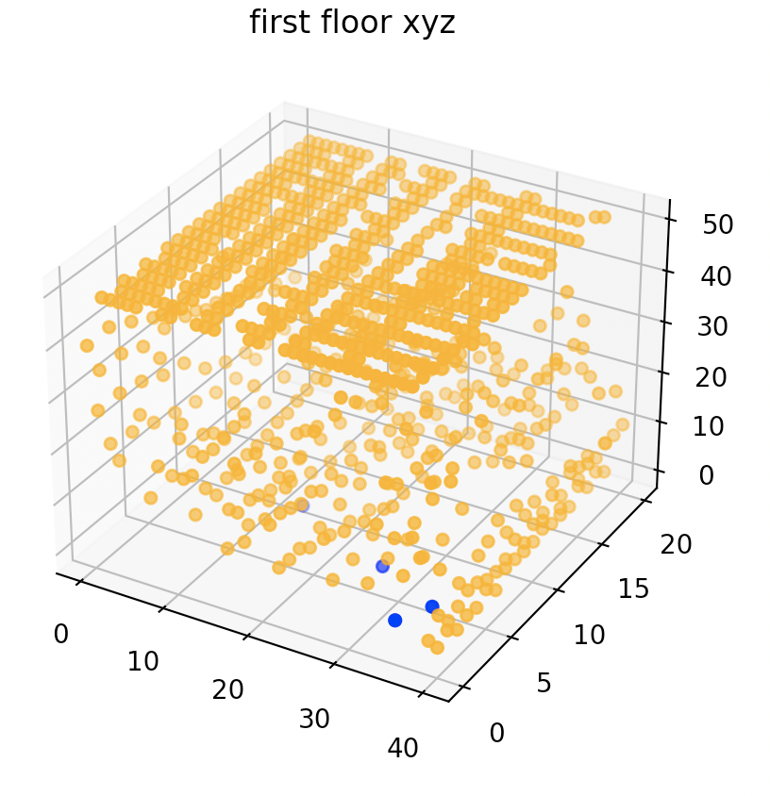
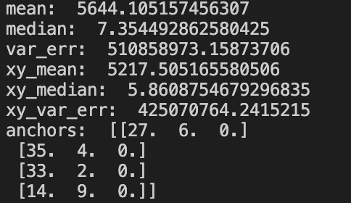
random sets of anchors for 10 times, each time with one round of rotation for initiating with DoP, noise mu = 0&var = 1m
Anchors 1st floor; samples 1st floor:
Median of errors for each sample point on x,y coordinates
Median of errors for each sample point on x,y,z coordinates

Slide 26
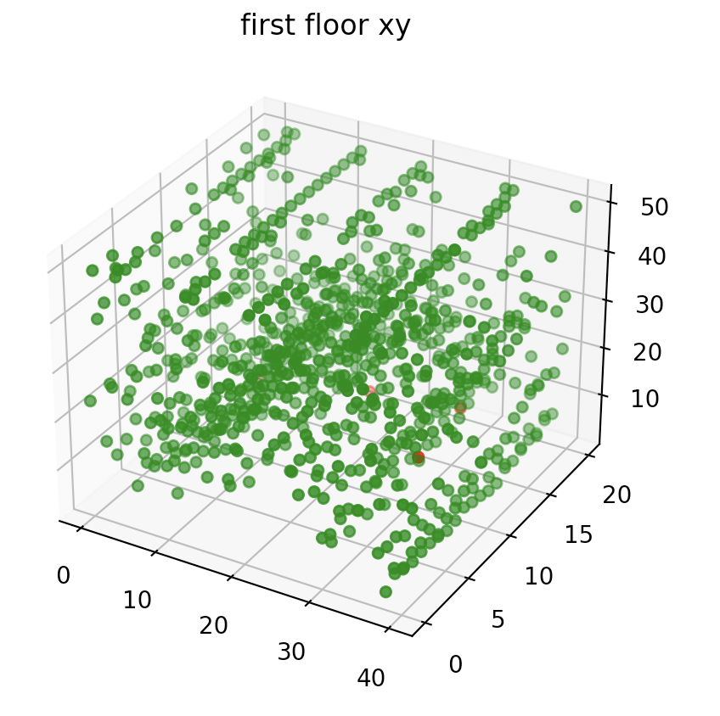
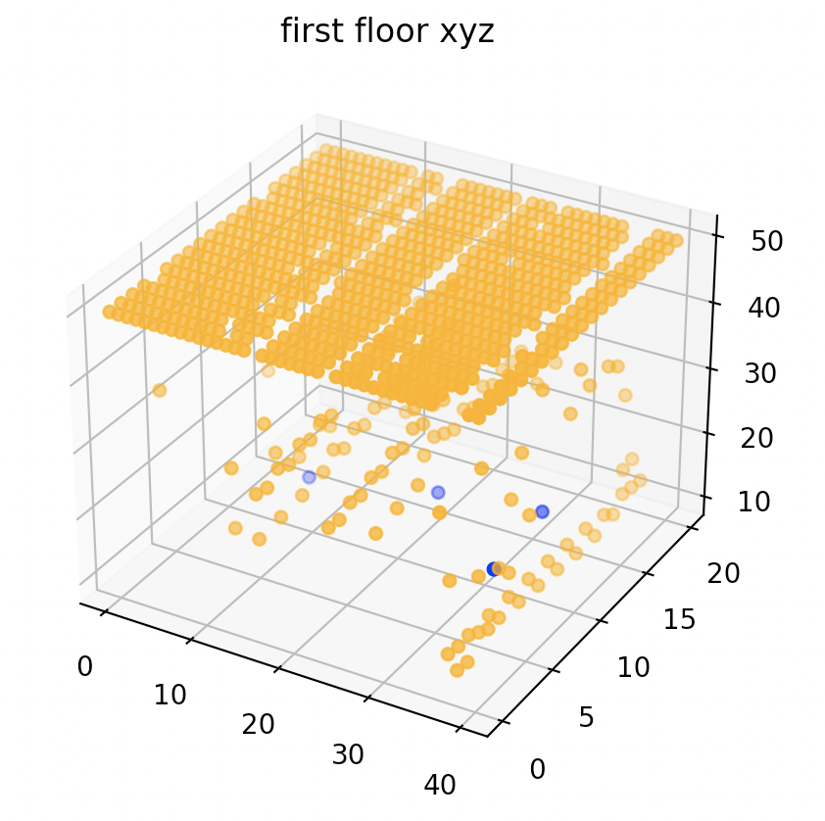
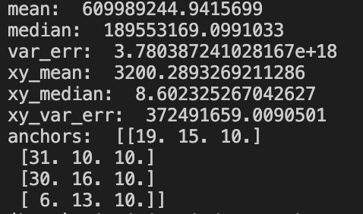
random sets of anchors for 10 times, each time with one round of rotation for initiating with DoP, noise mu = 0&var = 1m
Anchors 2nd floor; samples 1st floor:
Median of errors for each sample point on x,y coordinates
Median of errors for each sample point on x,y,z coordinates

Slide 27
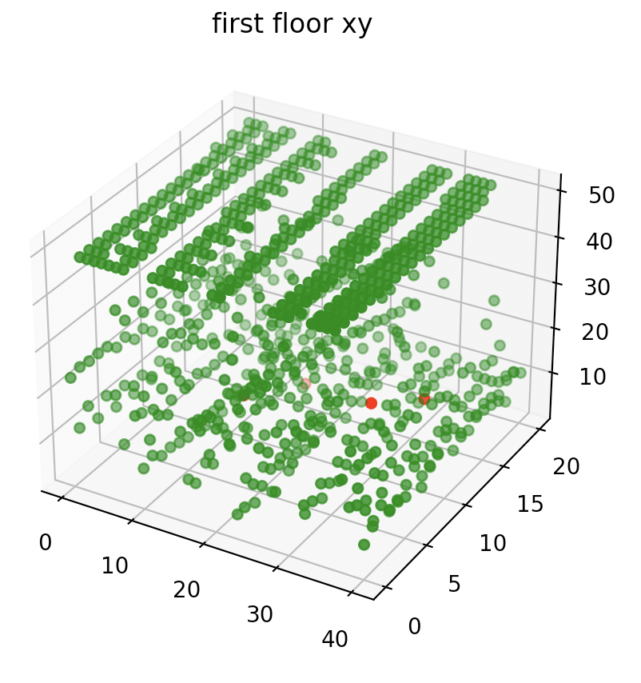
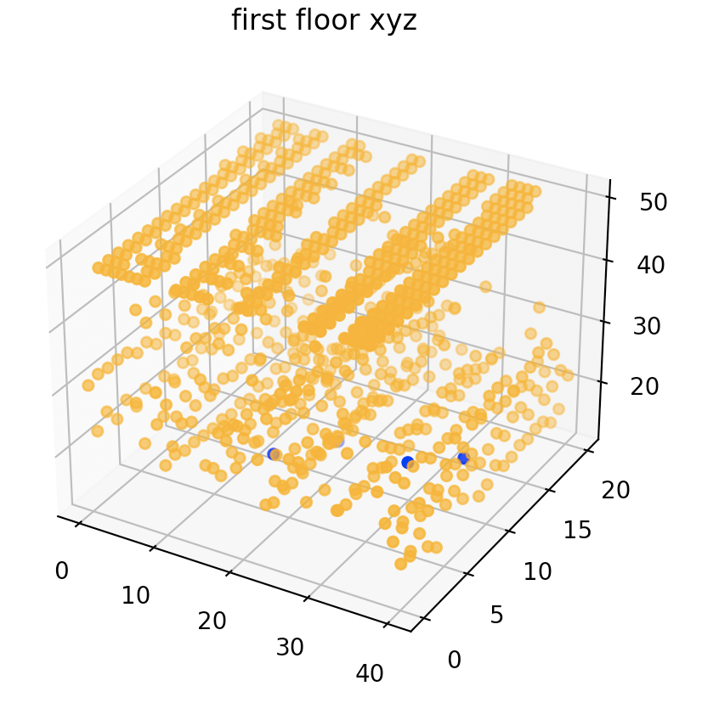
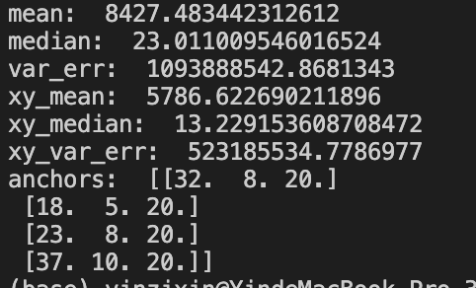
random sets of anchors for 10 times, each time with one round of rotation for initiating with DoP, noise mu = 0&var = 1m
Anchors 3rd floor; samples 1st floor:
Median of errors for each sample point on x,y coordinates
Median of errors for each sample point on x,y,z coordinates

Slide 28
Analysis: the errors caused by difference in z axis and anchor locations are mostly reflected on the z axis;
localization on x,y axis is robust to the above changes

Slide 29
A few sample points a lot iterations plot result positions on 3D plot;
Always anchor0 initiate;
One ground truth for each graph

Slide 30
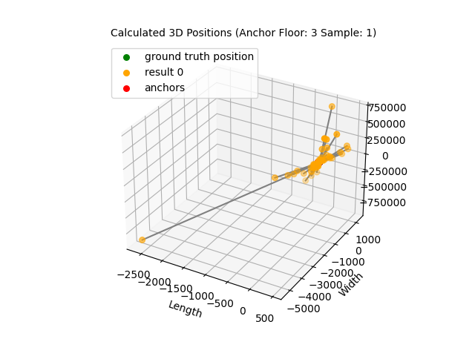
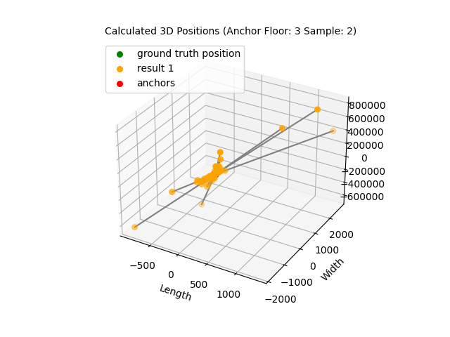
3D solver 3D plot

Slide 31
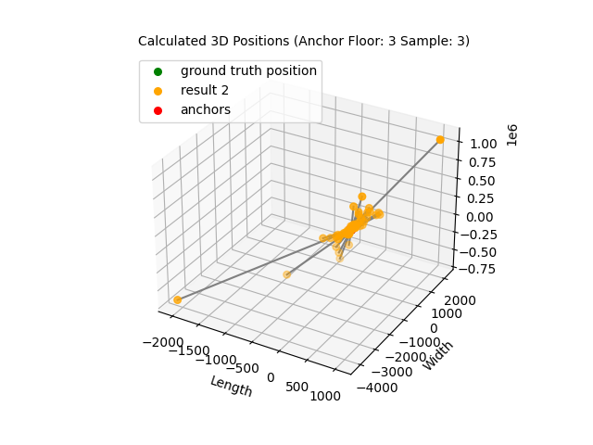
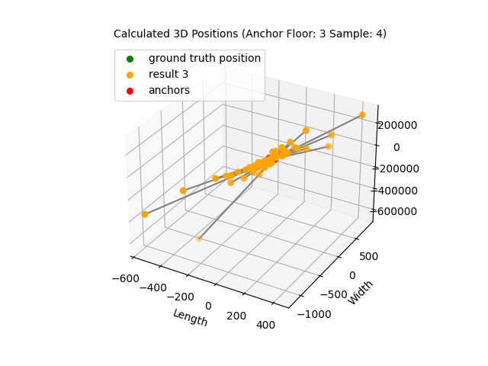

Slide 32
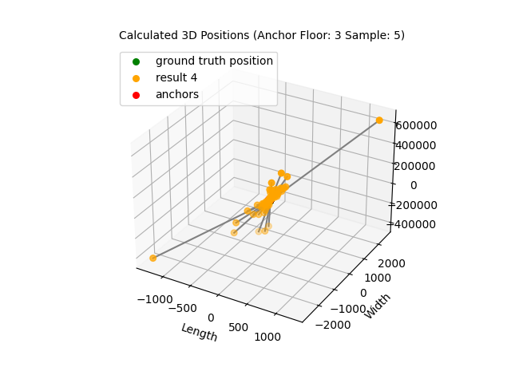

Slide 33
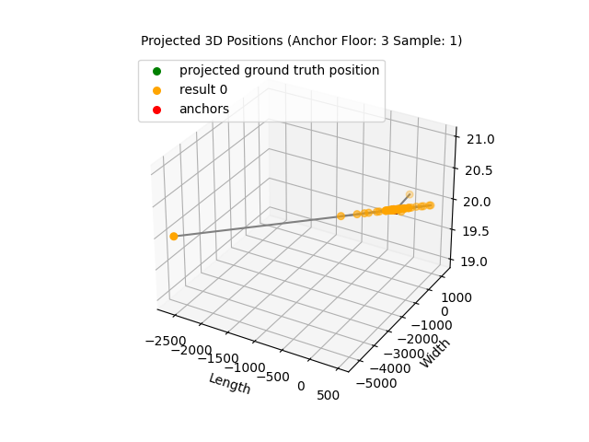
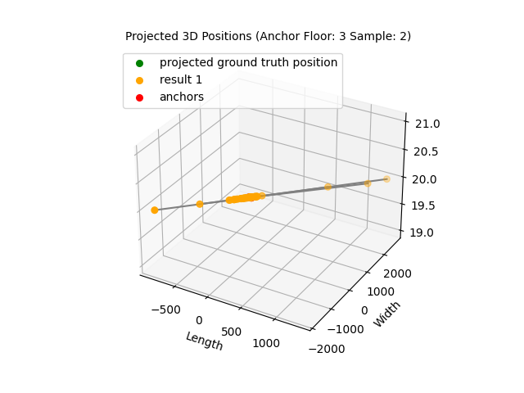
3D solver Projected plot

Slide 34
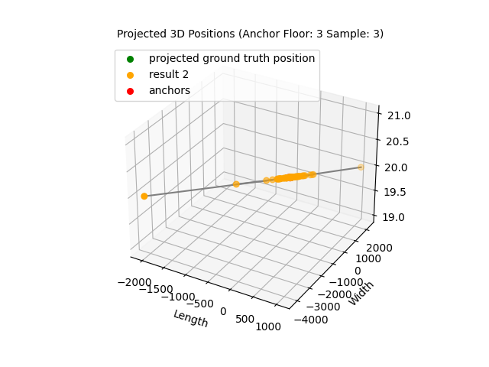
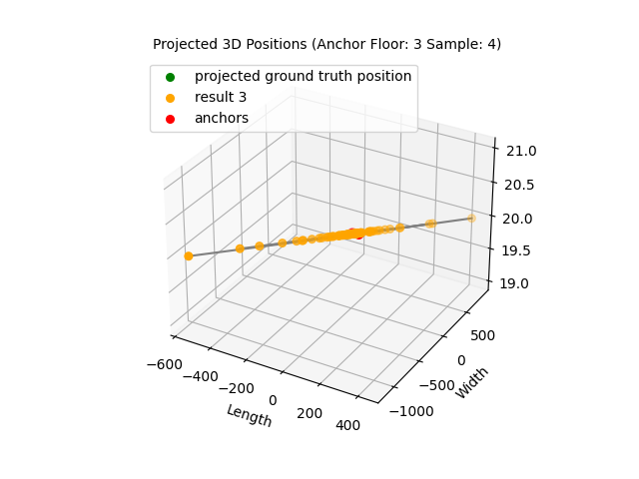

Slide 35
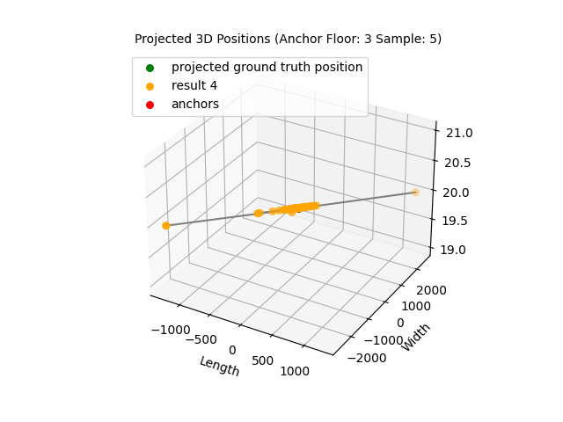
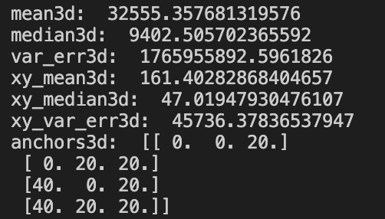

Slide 36

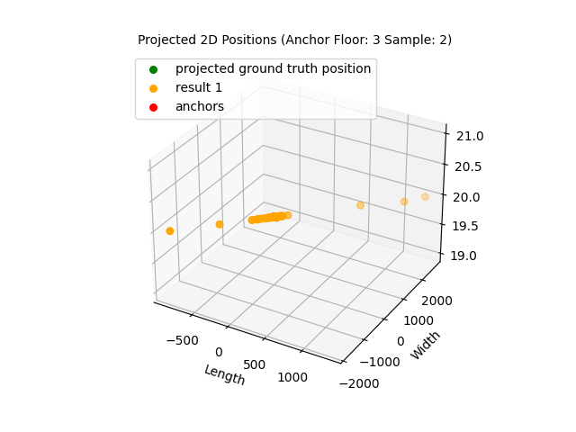
2D solver Projected plot

Slide 37
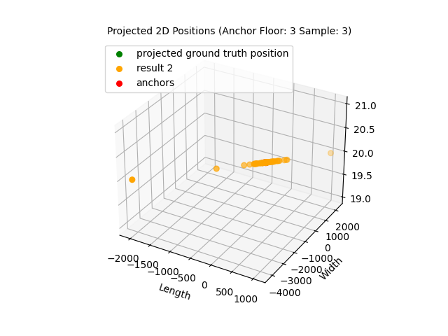
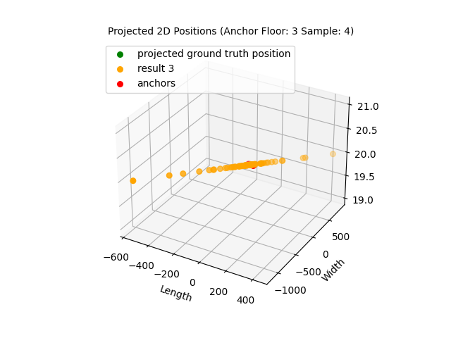

Slide 38
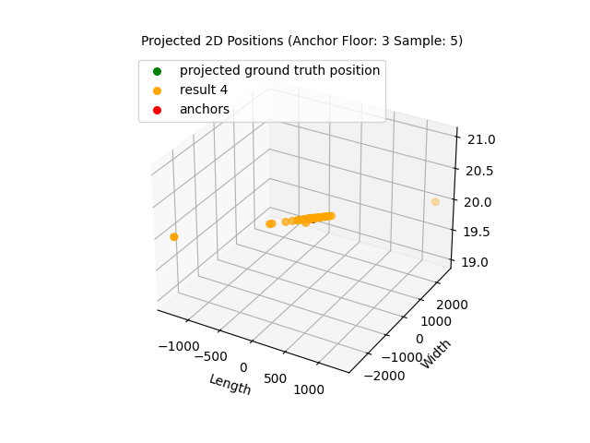
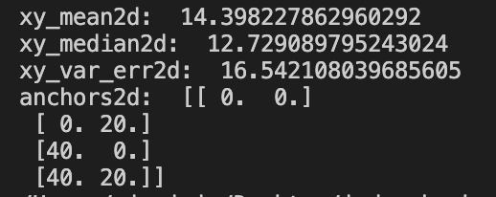

Slide 39
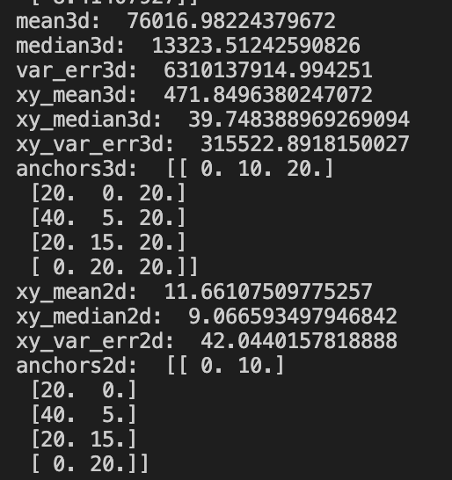
Analysis: by using anchors on the 3rd floor and sample points on the first floor,
the projected error produced by 2D solver is generally smaller than the projected
Error produced by 3D solver
Reasons could be scipy finds local minimal with a large z coordinate(vertical “half hyperbola”,
and that brings large errors to x y coordinates
Need at least 3 responders to generate single location result in hyperbolic model. Increase number of anchors:
Run with 5 anchors & at least 3 responders in each combo
3D model still generates larger errors on xy coordinates.
Could be caused by converging in 3D model

Slide 40
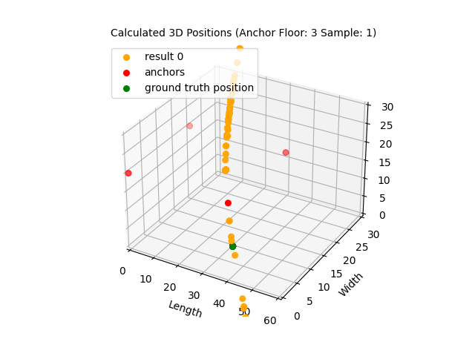
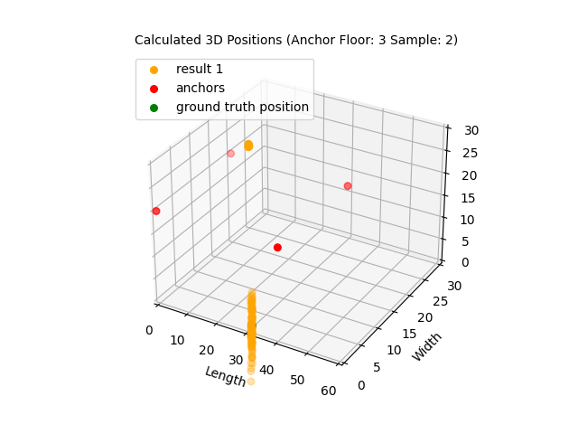
3D Results

Slide 41



Slide 42


Slide 43


Projected 3D Results

Slide 44



Slide 45


Slide 46


Projected 2D Results

Slide 47



Slide 48


Anchors on 3rd floor; Sample points on 1st floor:
Median error produced by 3D model on xy axis is smaller than median
Error produced by 2D model
Thus, using 3D model can potentially help us to determine whether users
Are using anchors from the correct floor numbers.

